Slide 1


Barriers to engagement
Philippa Williams – VP Sport & Deputy President
Alex Doyle – VP Activities

Slide 2
Methodology

Slide 3
Wednesday Afternoons
Purpose of the research was to investigate:
Do students have formal study timetabled on a Wednesday Afternoon
Why?
To improve the student experience
To create a level playing field amongst students across different faculties
Widening participation
To link into wider University strategy regarding health and wellbeing

Slide 4
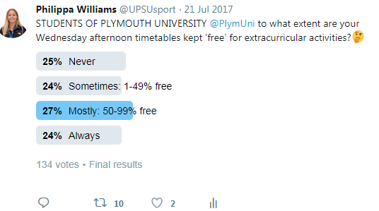
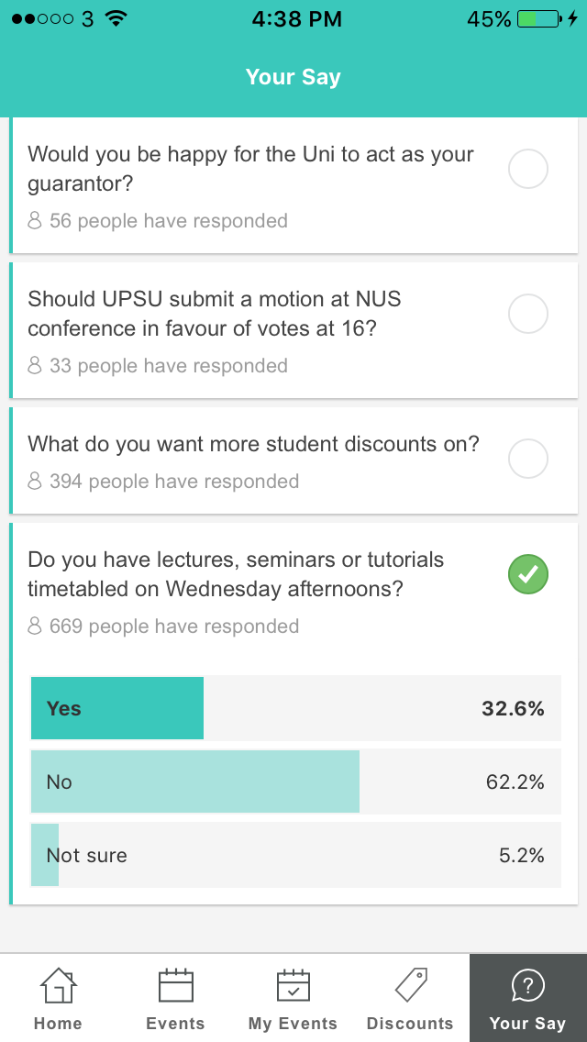
Wednesday Afternoon Timetabling
Gained student feedback via social media platforms
On average 30-35% do not have free Wednesday Afternoons
Twitter Poll
Have your say: UPSU App

Slide 5
Barriers to Engagement Survey

Slide 6
Barriers to Engagement Survey

Slide 7
Barriers to Engagement Survey

Slide 8
Barriers to Engagement Survey

Slide 9
Barriers to Engagement Survey

Slide 10
Student Feedback: Common Themes
Sports Clubs and Societies
Whole days required for Away Fixtures
Difficulty to field teams
Reduces Engagement
Compromising situation- committee members
Distance- 1pm does not always allow sufficient time
Example:
‘In our first year we were constantly timetabled on Wednesday afternoons, this included our induction week, which was all up at PAHC so we missed out on fresher’s week activities. When we got the go ahead to start the SUP club at the end of last year, I spoke with the head of podiatry. She said it is because we are on a medical course and it is more demanding. This term we seem to have sessions finishing at 1pm most of the time but because we are up at PAHC we still miss out because of the journey into town’ Podiatry student
‘100% should be kept free, without this societies and sports club don't have that extra time to engage with students. In addition, some students use it as an opportunity to work.’ Robotics student

Slide 11
Student Feedback: Common Themes
Student Health and Wellbeing
Well Being
Disability Support
Opportunity to socialise
Supports Parental Responsibilities
Example:
‘Due to the assumption that Wednesdays are free, the counselling and wellbeing support service operates many of their group support sessions on Wednesday afternoon: women's group, the international student group, mood boost classes, mindfulness etc. I think that having the time off helps make these services accessible to more students. Unfortunately, I think that there is always going to be an element of prioritising at uni, but having no class on one afternoon certainly helps.’ Educational Studies student
‘Absolutely, I've had to leave lectures early for ADHD group/ get there late because of late lectures. Very annoying for me, and disruptive for the rest of the group (more so considering the target audience of the group, any excuse for us to get distracted)’ Dietetics student
‘As a single parent having the knowledge that wed afternoons are free means I can schedule appointments, eyetests etc, it means that my daughter's are able to attend after school clubs like brownies because I know I will be around (weekends are out as they are often at their dads) and that I have a definite day I can chose for parent teacher meetings etc. So to me it's important from that point of view. Similarly in the time between lectures and pickup time I have a guaranteed slot to fit in something regular on the social side. So yeah from a parenting point of view I find it extremely important personally.’ Biomedical Science student

Slide 12
Student Feedback: Common Themes
Other Opportunities
Opportunity to Volunteer
Opportunity for Part-time work
Self-directed study
Examples:
‘Wednesdays should be kept as self-directed study days or highly directed study days. I'm on placement whilst on the course, the placement area should be aware of your commitments and support your extra-curricular activities. The university wants to promote well rounded individuals then putting the sports and societies at the front of this will allow students to have a boarder skill base.’ Child Nursing student
‘Yes! I volunteer at a local rehab centre and with an ever changing timetable it's the one period I can guarantee them.’ Psychology student
‘I definitely support the core teaching hours remaining 9am - 1pm on a Wednesday as it allows for a break in the week where the majority of students like myself will catch up on things they haven't been able to fit in due to other work and commitments. Plus the time allows for personal development in other areas separate to our academic endeavours’ Civil Engineering student

Slide 13
Total number of individually timetabled sessions: 2247

Slide 14
Faculty of Business
The number of individual Wednesday Afternoon timetabled sessions, within the 2017-18 Academic year
Undergraduate
Postgraduate

Slide 15
Faculty of Arts & Humanities
The number of individual Wednesday Afternoon timetabled sessions, within the 2017-18 Academic year
Undergraduate
Postgraduate

Slide 16
Faculty of Health & Human Sciences
The number of individual Wednesday Afternoon timetabled sessions, within the 2017-18 Academic year
Undergraduate
Postgraduate

Slide 17
Faculty of Science & Engineering
The number of individual Wednesday Afternoon timetabled sessions, within the 2017-18 Academic year
Undergraduate
Postgraduate

Slide 18
PUPSMD

Slide 19
Recommendation: Keep Wednesday Afternoons Free
To re-visit the timetabling project and reduce the amount of sessions timetabled on Wednesday afternoons, except in exceptional circumstances i.e. Fieldtrips.
To extend the provisions to keep Wednesday afternoons free to students on all courses, including Postgraduate Courses.
To extent the policy to ensure that Wednesday timetabling is limited to 12pm, as this would allow more students to participate in the activities that may be a distance to travel.
To ensure all staff who schedule teaching hours on a Wednesday afternoon provide resources available to students who are unable to attend. This support should be fair across all students.
To support students where possible to get more involved with Sports, Societies and UPSU Activities on Wednesday Afternoons

Slide 20
Thank you

